Slide 1

Implementation of StegoGAN: Leveraging Steganography for Non-Bijective Image-to-Image Translation
Presented by: E Krishna Koushik(23MIA1107) ,
T Guru Raghav Raj,(23MIA1105) ,
R Amarendar Reddy(23MIA1012)
School of: Computer Science & Engineering, VIT Chennai
Guide: Dr. S. Geetha
Course: SWE1010 – Digital Image Processing Project,

Slide 2
The Challenge of Non-Bijective Image-to-Image Translation
Motivation: Beyond One-to-One Mapping
In image translation, a single input can often correspond to multiple valid outputs. This non-bijective mapping is common in complex real-world scenarios. However, traditional Generative Adversarial Networks (GANs), such as CycleGAN and CUT, are typically designed for one-to-one transformations.
One input, multiple valid outputs (non-bijective).
Traditional GANs assume one-to-one mapping.
Leads to artifacts, missing, or redundant features.
Problem Statement: Towards Clean and Realistic Translations
Our goal is to develop a GAN architecture capable of discerning and selectively processing features. This involves identifying which features are transferable ("matchable") and which are extraneous ("unmatchable"), effectively hiding the latter to produce higher quality translations.
Feature Learning
Steganographic Hiding
Realistic Translation
Design a GAN to learn and differentiate between matchable and unmatchable features.
Utilize steganography to conceal irrelevant regions, enhancing output clarity.
Generate clean, realistic image translations, exemplified by the Aerial ↔ Map domain.

Slide 3





StegoGAN: A Novel Approach to Non-Bijective Translation
Key Idea: Integrating Steganography into GANs
The StegoGAN framework, proposed by Wu et al. (ETH Zurich, 2024), introduces steganography to manage non-bijective translations by strategically hiding information within the generated images.
Architecture Overview
Encoder
Mask Predictor
Decoder
Extracts a comprehensive feature map (z) from the input image.
Divides z into z_matchable (transferable features) and z_unmatchable (features to be hidden).
Reconstructs the target image using only the z_matchable features.
Discriminator
Reverse Generator
A PatchGAN architecture ensures the realism and fidelity of the generated output.
Maintains cycle consistency by reconstructing the original input from the translated image.
Loss Functions for Robust Training
StegoGAN employs a combination of loss functions to optimize its performance and ensure stable training:
GAN loss for adversarial training
Cycle consistency loss for bidirectional mapping
Identity loss for preserving content when domains are similar
Mask regularization loss to guide the mask predictor

Slide 4
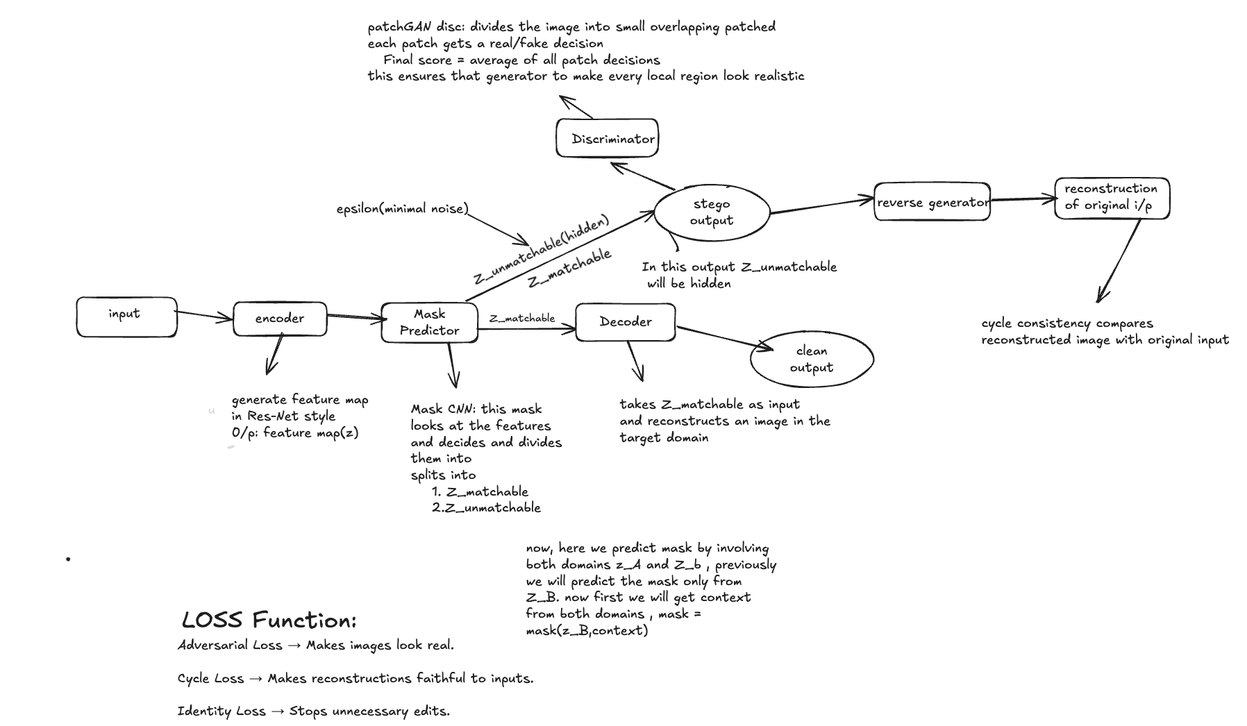
Methodology: Training StegoGAN for Aerial-to-Map Translation
Implementation Workflow
Our implementation closely follows the proposed StegoGAN architecture. We meticulously recreated the training pipeline, focusing on the interplay between the various components to achieve optimal results.
Dataset: PlanIGN (Aerial ↔ Map)
We used the PlanIGN dataset, which contains 1000 paired 512×512 Aerial–Map images. It is suitable for testing non-bijective translation because aerial photos and their maps share some features but also differ significantly.

Slide 5
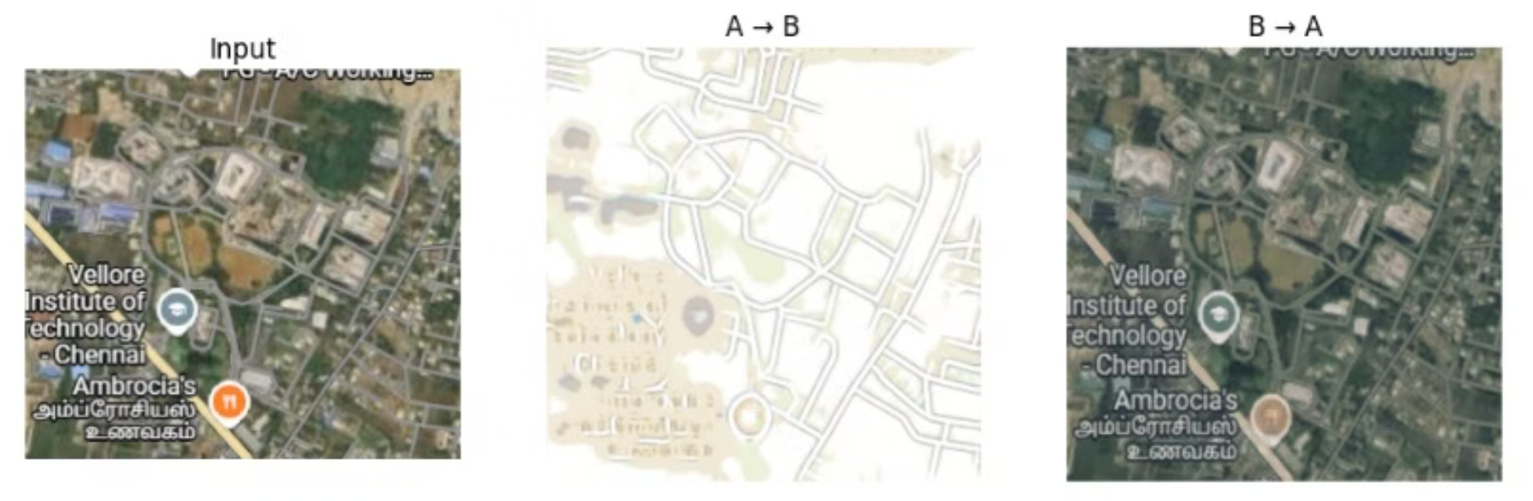
Quantitative Results: Validating StegoGAN's Performance
Metrics on PlanIGN Dataset
Our reproduction of StegoGAN yielded highly competitive results, showcasing significant improvements in key metrics compared to the original paper's reported values in some areas, especially in pixel-level accuracy.
StegoGAN (Paper)
Ours
RMSE ↓
22.5
10.48
Acc(σ₁) ↑
66.1
79.89
Acc(σ₂) ↑
74.8
84.54
FID ↓
58.4
58.53
KID ↓
2.4
2.09
Successfully reproduced the paper's results with notable improvements in pixel-level accuracy and visual fidelity. The mask_mean stabilized early at approximately 0.095, indicating consistent feature selection.
Visual Examples: Aerial to Generated Map

Slide 6
Key Findings and Insights
Our implementation and experimentation with StegoGAN have yielded several important observations, confirming the model's capabilities and highlighting areas of strength.
Architecture Fidelity
Competitive Performance
Enhanced Resolution & Accuracy
Successfully reproduced the intricate StegoGAN architecture and its associated training pipeline, validating its design.
Achieved FID and KID scores (≈ 58 and ≈ 2 respectively) highly comparable to the original paper's reported values.
Fine-tuning at 512×512 resolution significantly improved RMSE and overall accuracy, especially in pixel-level details.
Stable Mask Prediction
Visual Quality
The mask predictor consistently stabilized early in training (around 327 epochs), indicating robust feature selection.
Generated outputs are visually clean and structurally accurate, demonstrating the effectiveness of the steganographic approach.

Slide 7



Future Enhancements: Towards Cross-Domain StegoGAN
Proposed Enhancement: Leveraging Cross-Domain Attention
The current StegoGAN model predicts the mask using features exclusively from the same domain as the input. We propose an enhancement that incorporates target domain features into the mask prediction process through a cross-domain attention mechanism.
Why Cross-Domain Attention?
By considering features from the target domain, the mask predictor can develop better context awareness, leading to more semantically aligned and structurally sound translations.
Better Context
Structural Alignment
Improved Generalization
Improved awareness of target domain semantics.
Enhanced preservation of small, critical structures (e.g., cars, trees, shadows).
Greater adaptability across diverse image domains.

Slide 8
Conclusion & Future Outlook
Key Achievements
Successfully implemented and validated the StegoGAN architecture on the PlanIGN dataset.
Achieved performance metrics (FID ≈ 58, KID ≈ 2) nearly identical to the original research paper.
Demonstrated the model's ability to produce visually clean and accurate image-to-image translations in non-bijective scenarios.
This project not only validates the efficacy of StegoGAN in handling the complexities of non-bijective image translation but also lays the groundwork for more context-aware and robust future iterations.
Proposed Future Work
Our proposed Cross-Domain StegoGAN aims to further refine mask prediction by integrating target domain features, promising even greater semantic consistency and structural accuracy in future image translation tasks.
References
Wu et al., StegoGAN: Leveraging Steganography for Non-Bijective Image-to-Image Translation, 2024
Zhu et al., CycleGAN: Unpaired Image-to-Image Translation using Cycle-Consistent Adversarial Networks, ICCV 2017
Park et al., Contrastive Unpaired Translation (CUT), ECCV 2020

